Slide 1
Coupler les transitions AE et numérique: les enjeux
Véronique Bellon Maurel, INRAE-#DigitAg

Slide 2
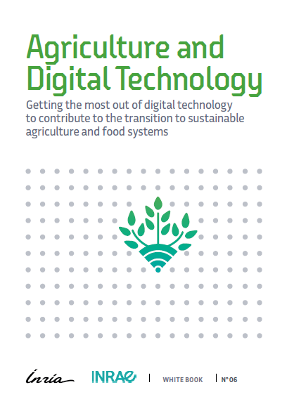
Making twin transitions possible?
Digital Transition
Agroecological Transition
Food System Transition
Synergy
Agroecology ss largo (autonomy)
The framework
Making digital techs desirable, useful & used
Confront Opportunities & Risks => Research Challenges
2

Slide 3
0pportunity/Risks => 4 research challenges
Opportunities
= Better Production (reduction of impacts & tediousness , alerts, planification..)
= Better Inclusiveness ( value chains/ territories)
= Better Knowledge Sharing (capitalize, share)
(+ Southern countries)
Risks
= Digital DivideS (acces)
= Technical (cybersecurity, complexification)
= Economical (power control, advisory activities)
= Social (identity, deskilling)
= Sovereinty loss ( from the farmer to the nation: data governance)
= Ecological (links to nature, impact of ICTs, locking)
1
Data & Knowledge
3
Territorial management
2
Transforming value chains
Farm management
4
3
3
3

Slide 4
1
Creating and sharing data & knowledge
More and more
numerous and heterogeneous data
Which security for data flows?
Which governance ?
Which equity on data/ knowledge sharing ?
Robots need data for action
Robots generate data from action
Which ontologies to collect & connect different pieces of knowledge?
How to hybrid existing and new knowledge?

Slide 5
2
Farm Management
LowCost Sensors
Distributed & frugal data treatment
Integrating uncertainty
Perception
User-centered decision aid systems
Decision aid
Early detection of disease & stress
Integrating expert knowledge
Data fusion
=> indicators
Representing complex socio-agroecosystems
Security
Secured and precise geolocation
Robotics
Man-machine and machine-machine interaction & coordination
Dynamic perception & adaptation
5

Slide 6
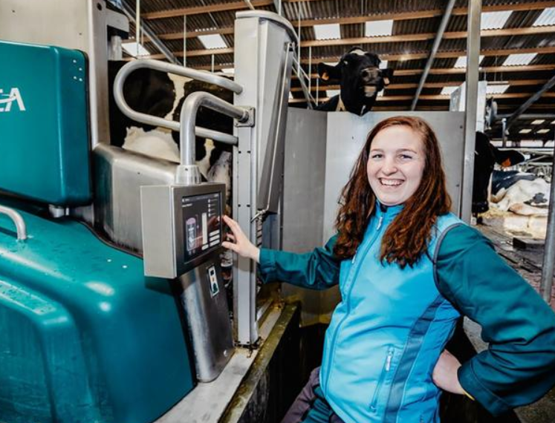
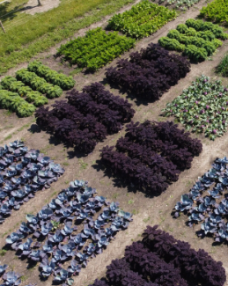
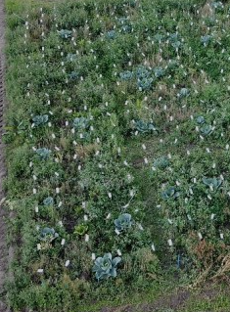
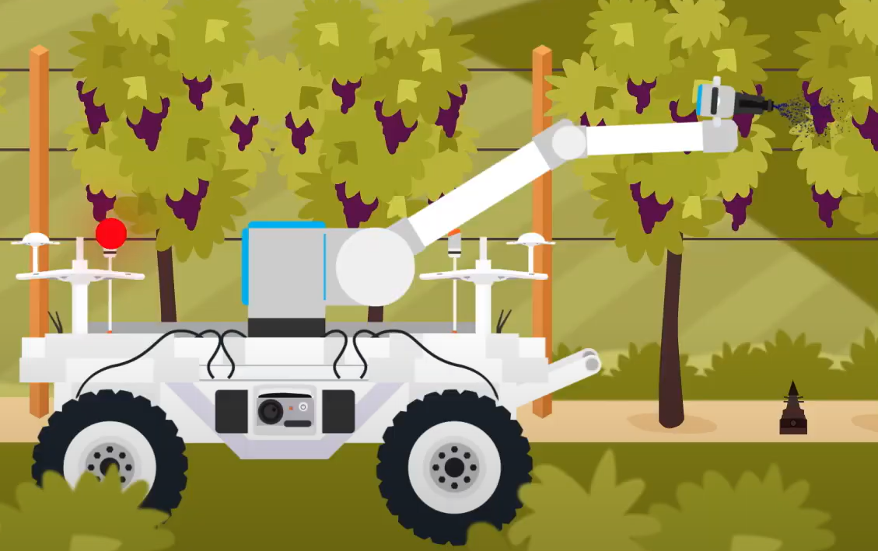
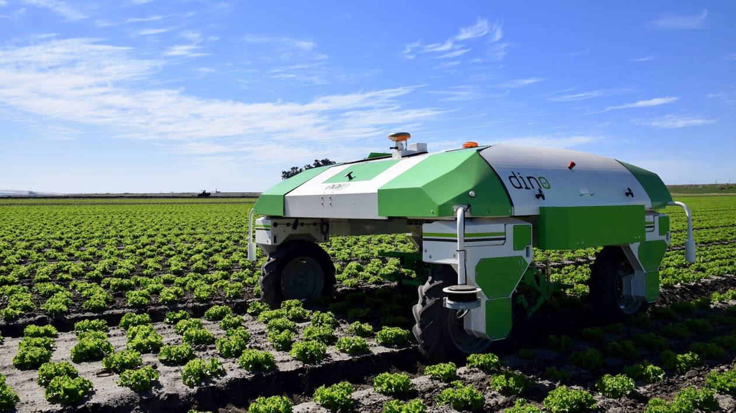
Which synergies between robotics & AE ?
Improving farmer’s quality of Life
A breeder happy with her milking robot Source: L’action agricole picarde
Cropping Diversity (pixel cropping)
Pixel Farming Pixel Cropping (WUR) Agroforestry (PretaTerra)
Precisely applying (stimulants and biopesticides)
Smash (Yanmar) precision spraying
Substituing herbicides
Dino at work

Slide 7
Transversal issues
1
2
3
4
Creating and sharing data & knowledge
Helping farmers in farm management
Accompanying the collective management of territories
Transforming value chains
Holistic Approach
Searching Resilience not optimum
Frugality
(Green IT)
Confidence (security, transparency)
7

Slide 8
Take home messages
Several agricultures => several digital technologies (Schnebelin et al., 2021)
Research must target « responsible digital agriculture » (RRI) => inclusion of users & anticipation of impacts
Bottlenecks are technical but also organisational, economical, social =>
mobilising digital sciences, SHS, economical and management sciences, political sciences.
Inter- and trans-disciplinary R&I is needed
8

Slide 9
Thank you
www.occitanum.fr
Le Livre Blanc Agriculture et Numérique
The White Book
Agriculture & Digital Techs
9

